Slide 1
Chapter 1
Introduction to Principles of Distributed Systems

Slide 2
Distributed Computing
Addresses algorithms for a set of processes that seek to achieve some form of cooperation
Processes running concurrently
typically, we replicate processes for tolerating faults of individual processes
Some processes WILL fail while others must keep operating/cooperating in spite of these failures
Partial failures is a characteristic of modern Distributed Systems
Leslie Lamport:
“A distributed system is one in which the failure of a computer you did not even know existed can render your own computer unusable.”

Slide 3
the challenge
Because most systems deal with some form of asynchrony, it is impossible to tell whether:
A process has failed
The network has failed
The challenge in distributed computing is precisely to devise algorithms that provide the processes that remain operating with enough consistent information so that they can cooperate correctly and solve common tasks

Slide 4
Abstractions
Abstractions help distinguish the fundamental from the accessory
Prevents system designers and engineers from reinventing the same solutions for slight variants of the same problems
Basic Abstractions of the underlying physical system:
Processes (represented by):
a computer
a processor within a computer
a specific thread of execution within a processor
Links that support the message passing over a communication network, which is the basis of cooperation
Timing Modules (e.g., failure detectors)
Cryptography

Slide 5
From basic abstractions to models
It is thus possible to represent multiple realizations of a distributed system by capturing different properties of processes and links by:
describing how these elements may operate
describing how these elements may fail
And that under different environmental conditions
These are what become Distributed System models

Slide 6
From models to higher-level abstractions
Given a system model:
the next step is to understand how to build abstractions that capture recurring interaction patterns in distributed applications
We want thus to build abstractions that capture robust cooperation problems among groups of processes built on the underlying basic abstractions (processes and links)
This cooperation can be modeled as an agreement problem
Did a particular event take place?
What is the common sequence of actions to perform?
What is the order by which a set of inputs need to be processed?

Slide 7
from the simple to the complex
It is desirable to establish more sophisticated forms of agreement from solutions to simpler agreement problems
In an incremental manner
To exchange information processes must agree on:
Who they are
Common format for messages passed around
How to exchange those messages

Slide 8
from the simple to the complex cont.
After exchanging messages, the processes may be faced with several alternative plans of action
Consensus on a common plan out of several alternatives
each process may have its own distinct plan
From there, processes may need to agree on whether a particular step should be taken or not
Known as the atomic commitment problem
Processes may need to agree on the order in which these actions should be executed
This is the basis of one of the most fundamental techniques to replicate computation in order to achieve fault tolerance
Known as Total-order Broadcast

Slide 9
therefore
We thus wish to devise abstractions that encapsulate such problems
Very difficult because:
coordination among processes
processes may fail
processes may behave maliciously

Slide 10
Applications that require distributed programming abstractions
Information dissemination engines
Publish/subscribe
Messages sent using Best-effort or Reliable Broadcast
Multiuser cooperative systems
Distributed shared spaces (shared memory)
Physically separated memories accessed through one memory address space

Slide 11
Applications that require distributed programming abstractions cont.
Process control systems
Several software processes using sensors to control the execution of a physical activity (examples include):
dynamic control of airplane or train
controlling the temperature of a nuclear installation
the automation of a car production plant
Captured via the Consensus abstraction
Notes:
print a single location of the aircraft on the pilot control screen, despite the fact that, due to the inaccuracy or failure of their local sensors, they may have observed slightly different input values

Slide 12
Applications that require distributed programming abstractions cont.
Cooperative work
Shared workspace such as a document or source code
Online chat
Virtual conference
Uses distributed shared memory abstractions
works using read and write operations

Slide 13
Applications that require distributed programming abstractions cont.
Distributed databases
Transaction managers obtain a consistent view of the running transactions and can make consistent decisions on how these transactions are serialized
Achieved using the Atomic Commit abstraction
Decides whether to commit or abort a particular transaction
Distributed storage systems

Slide 14
Modularity
To implement these abstractions, we will be taking a modular approach
Separating the relevant logic of the abstraction with the application logic
abstraction is implemented as an independent service that can be accessed through a well-defined interface
End-to-end Argument
Most complexity should be implemented at the higher levels of the communication stack

Slide 15
Modularity cont.
A given problem may have multiple solutions depending on:
differing network or load conditions
Each solution has its own advantages/disadvantages
usually different trade-offs between network traffic and message latency
Allows the most suitable implementation to be selected when the application is deployed
Or even allows choosing at runtime among different implementations in response to changes in the environment
Promotes system portability

Slide 16
algorithms and implementations
We will be working with pseudo-code to form algorithms
We will implement many of these algorithms in Java using the Appia framework
Reactive computing model
Components of a single process communicate through exchanging events
An algorithm is thus described as a set of event handlers
react to incoming events and possibly trigger new events
Abstractions represented through an API

Slide 17
components
Called modules in our case
Identified by a name, and characterized by a set of properties
Each component provides an interface in the form of the events that the component accepts and produces in return
A collection of components is what comprises a distributed programming abstraction

Slide 18
Software stacks
Components can be composed to build software stacks
Each component represents a “layer” in the stack
Application layer is at the top
Networking layer is usually at the bottom
The layers of the distributed programming abstractions are typically in the middle
Components communicate through the exchange of events

Slide 19
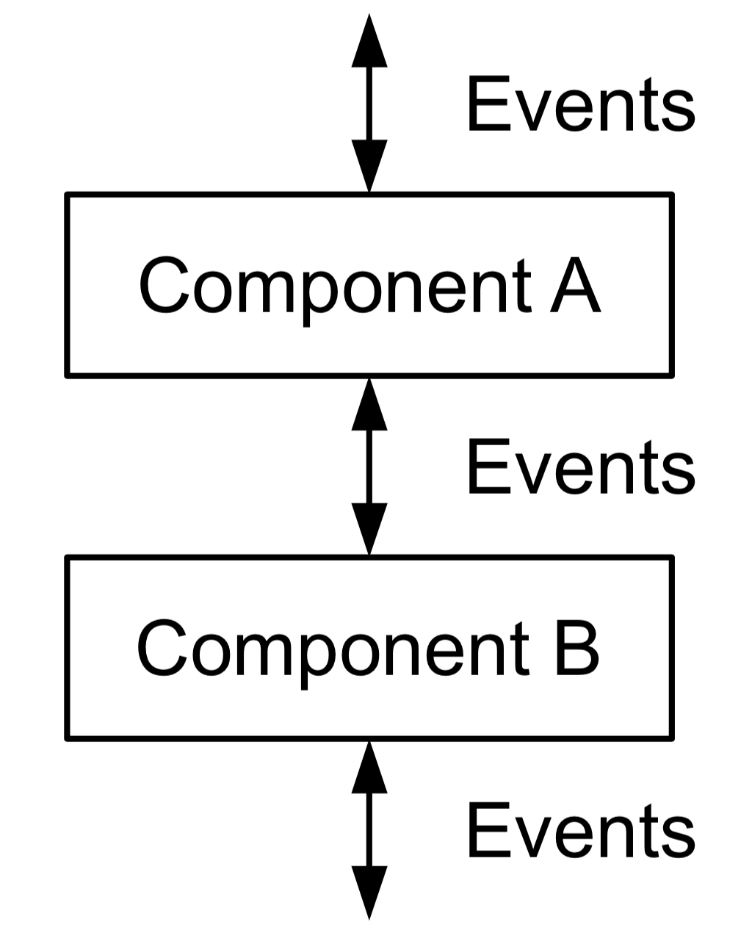
composition model
Each component is constructed as a state-machine
transitions are triggered by the reception of events

Slide 20
Events
Events may carry information such as a data message, or group membership information, in one or more attributes
Events are denoted by:
⟨ EventType | Attributes, . . . ⟩
For events defined for component co:
⟨ co, EventType | Attributes, . . . ⟩
Events processed through handlers

Slide 21
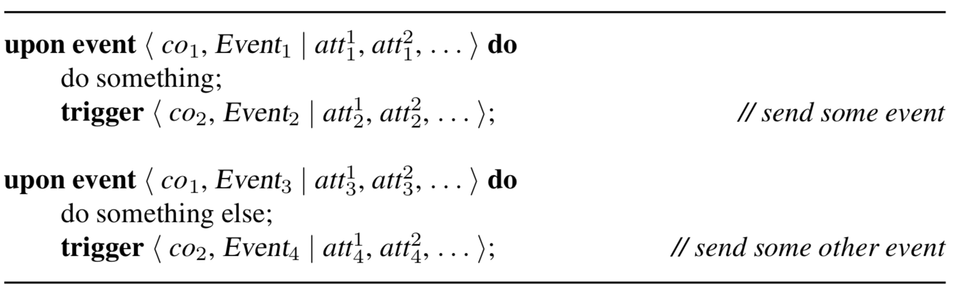
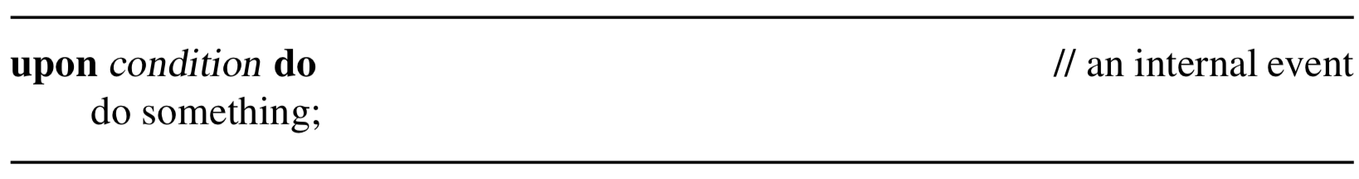
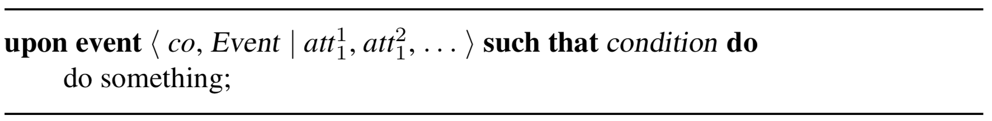
example handler
Notes:
Events are processed one at a time, NOT concurrently
placing conditions on event handlers could lead to the need for infinite buffers…

Slide 22
Programming interface
Our component APIs include two types of events:
Requests (inputs)
used by a component to invoke a service at, or to signal a condition to, another component
Indications (outputs)
used by a component to deliver information or to signal a condition to another component
Can carry payload or signaling information (“something happened” — conditions for synchronizing two layers )

Slide 23
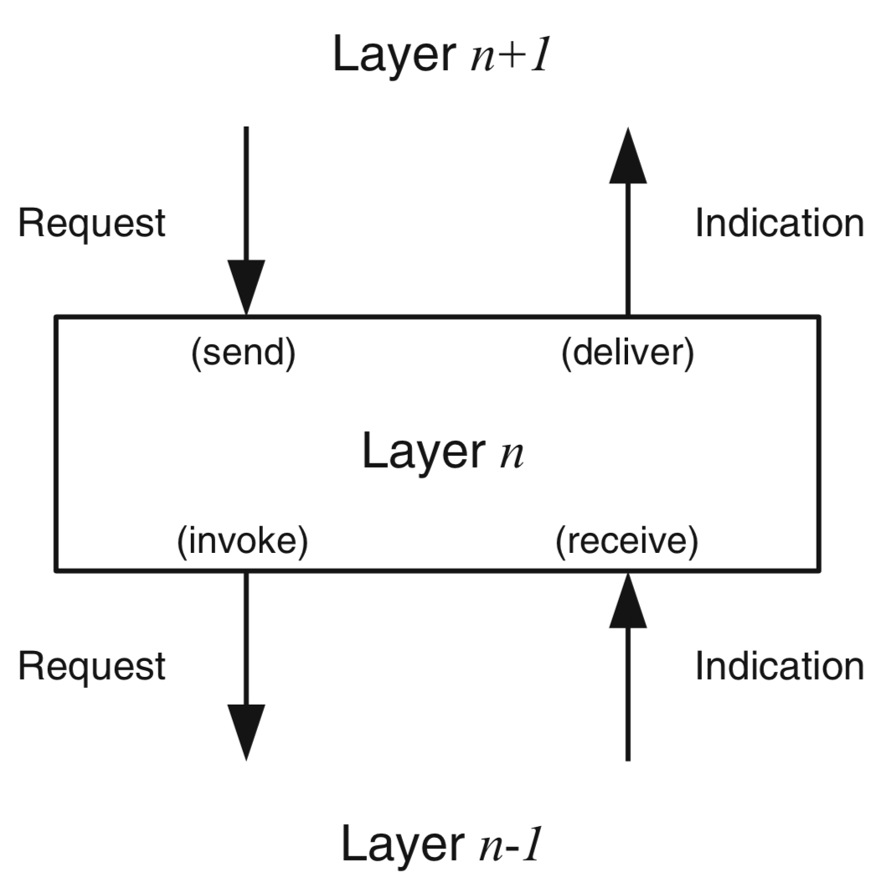
Layering
Notes:
Example (broadcast layer)
1. The procedure for sending a broadcast message is initiated by the reception of a request event from the layer above.
2. To ensure the properties of the broadcast abstraction, the layer will send one or more messages to its remote peers by invoking the services of the layer below (using request events of the lower layer).
3. Messages sent by the peer layers are also received using the services of the underlying layer (through indication events of the lower layer).
4. When a message is received, it may have to be stored temporarily until the adequate reliability property is satisfied, before being delivered to the layer above using an indication event.

Slide 24
Modules
The modules we will be studying will perform one of the following:
Interaction with corresponding modules on other processes
Local actions

Slide 25
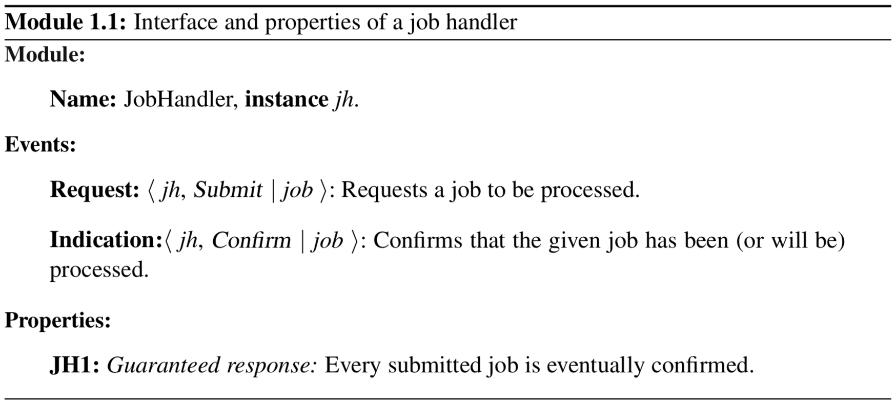
Example module
Notes:
interface explicitly leaves open whether or not the job has been processed at the time when the confirmation arrives

Slide 26
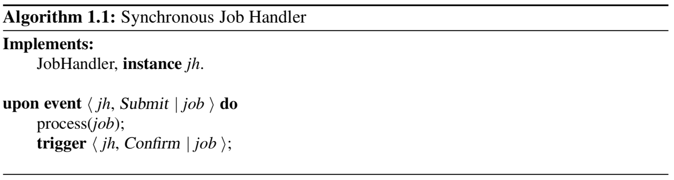
algorithm that implements the job handler (synchronous version)

Slide 27
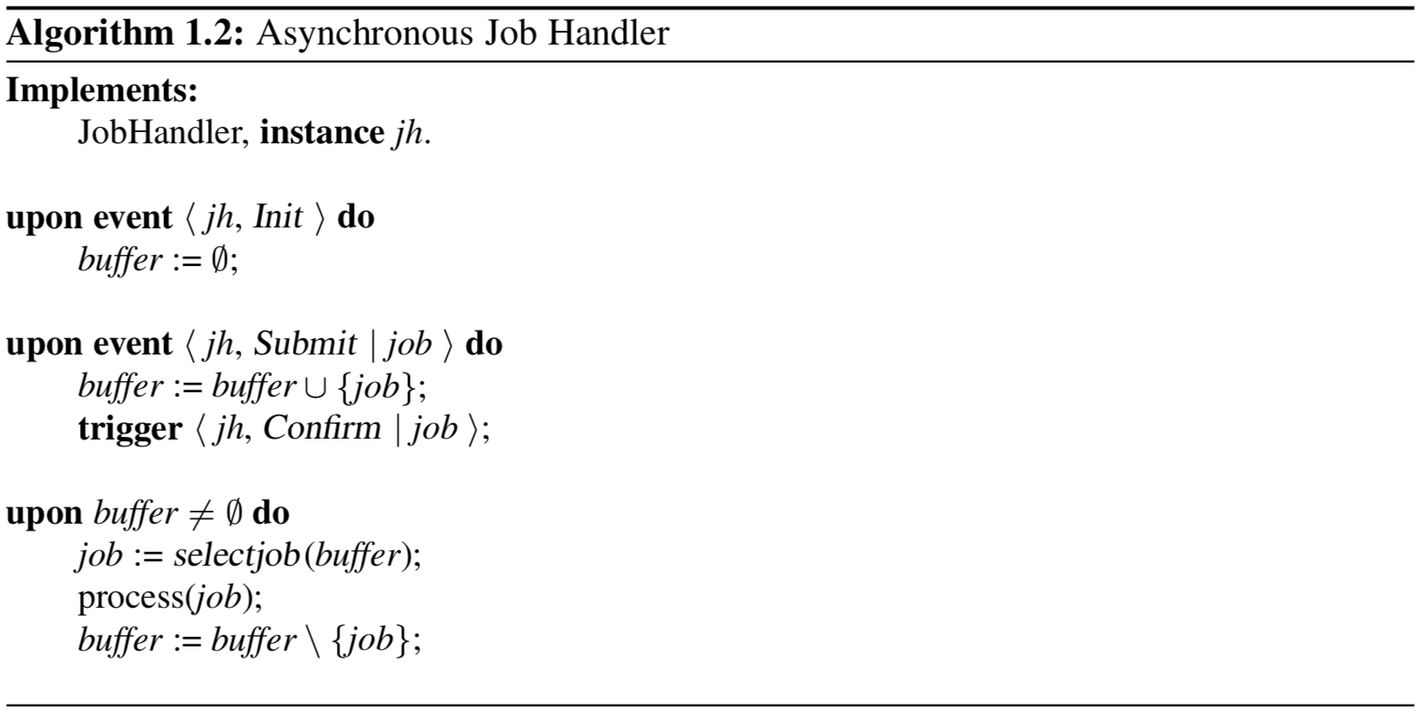
algorithm that implements the job handler (asynchronous version)

Slide 28
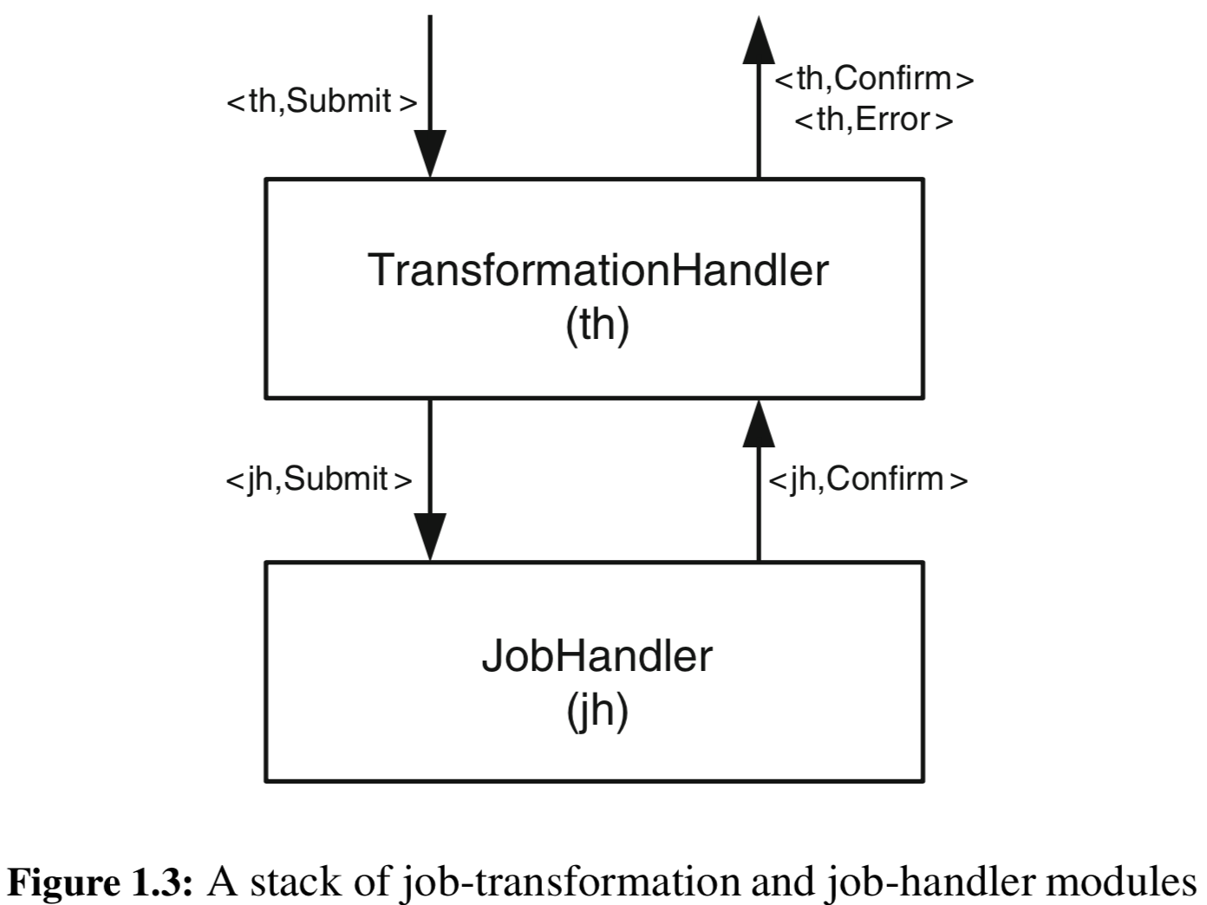
composing modules on modules
Notes:
we use the job-handler module and extend it by a module that adds a layer on top

Slide 29
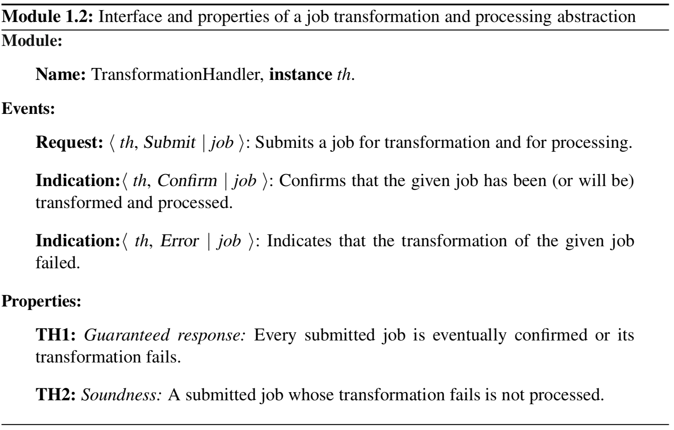
Another example module

Slide 30
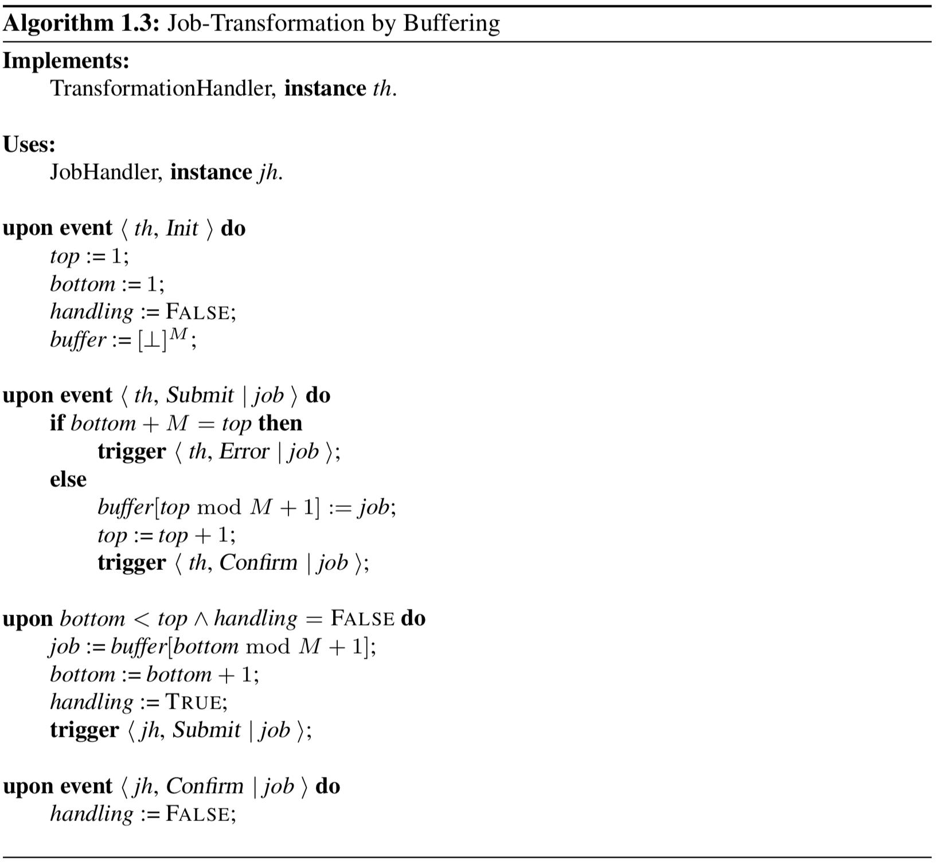
Notes:
The layer implements a bounded-length queue of jobs waiting to be processed
The algorithm interacts synchronously with the underlying job handler and waits before submitting the next job until the previously submitted job has been confirmed
When Algorithm 1.3 is combined with the synchronous job handler (Algorithm 1.1), the run-time system does not need any unbounded buffers

Slide 31
classes of algorithms
Failure assumptions, the environment, the system parameters, and other design choices affect the algorithm design
Leads to different classes of algorithms

Slide 32
classes of algorithms cont.
Fail-stop
processes can fail by crashing
can be reliably detected by all the other processes
Fail-silent
processes can fail by crashing
process crashes can never be reliably detected
Notes:
important to note that we do not give a solution from each class for every abstraction

Slide 33
classes of algorithms cont.
Fail-noisy
processes can fail by crashing
crashes can be detected
BUT not always in an accurate manner (accuracy is only eventual)
Fail-recovery
processes can crash and later recover and still participate in the algorithm
Notes:
important to note that we do not give a solution from each class for every abstraction

Slide 34
classes of algorithms cont.
Fail-arbitrary
processes can deviate arbitrarily from the protocol specification and act in malicious, adversarial ways
Randomized
processes may make probabilistic choices by using a source of randomness
Notes:
important to note that we do not give a solution from each class for every abstraction

